Slide 1


Getting Started With Xamarin and Visual Studio 2015
John Hadzima
Senior IT Consultant
Marathon Consulting

Slide 2



John Hadzima
Senior IT Consultant Marathon Consulting
Organizer Hampton Roads .NET Users Group
@JohnHadzima
Twitter

Slide 3








Hampton Roads User Groups

Slide 4
Agenda
Architecting Mobile Apps
Microsoft and Xamarin
Traditional Xamarin
Xamarin Forms
Setup and Solution Types
Emulators/Debugging
Resources

Slide 5
Architecting Mobile Apps

Slide 6
Architecting Mobile Apps – Silo Approach
Objective-C / Swift
Java
Xcode
Eclipse / Android Studio
Pros
Native applications
Full IDE available
Cons
No Shared Code
Multiple Teams/Codebases
Platform specific bugs
Expensive/Slow
Notes:
Back in the day this was how it was done.
Apps looked/acted different on each platform
Now they act more alike Windows UWP, Google – Material Design
Xcode not a great IDE
Objective-C very much like C with memory management, header files, strange syntax
Swift is easier syntax
Eclipse is a terrible IDE and hard to configure
Google created Android Stuido, based on IntelliJ (ReSharper), easy for VS developers to pickup, v2 out
Very tough for .NET developers to do
http://www.ingamestatsapp.com/ -> show app

Slide 7

Architecting Mobile Apps – Black Box Approach
Apache Cordova
HTML/JavaScript/CSS
Pros
Shared Code
Leverage existing web skills
Cons
Limited access to native API
New or Advanced Features Not Available
Performance (especially Android)
Notes:
Iconic framework
API access has gotten better
Browser emulator
Android performance
New features like NFC or Google Play

Slide 8
Architecting Mobile Apps – Xamarin’s Approach
iOS C# UI
Android C# UI
Windows C# UI
Shared UI Code
Shared C# Backend
Shared C# Backend
Traditional Xamarin
Xamarin Forms
Notes:
This is not a new approach, about half of all 3d games for iOS/Android/Windows are developed with Unity which uses C# on a subset of Mono
That small sliver is platform specific code (NFC, Android Wear, Apple Play)
Get about 90% code sharing (more on Windows less on Mac)
Windows Phone 8.1 and Windows UWP (Windows 10, Surface, Xbox, HoloLense)

Slide 9
Architecting Mobile Apps – Xamarin’s Approach
Built on .NET
Use Standard .NET APIs
C# 6 (LINQ, async await, delegates)
Code can be shared across platform
100% Native API coverage (iOS, Android, Windows)
Anything you can do in Objective-C / Swift or Java can be done in C# with Xamarin.
Generates native apps (ARM and APK)
Full support on each platform for Phones, Tablets, Gear (Apple Watch, Android Wear, Microsoft Band)
Notes:
runs natively on both platforms
iOS -> ARM binary APP,
Android -> APK use Just In TIme compilation on Android
No performance issues, native apps
Show VS Toolbox project for C# code

Slide 10
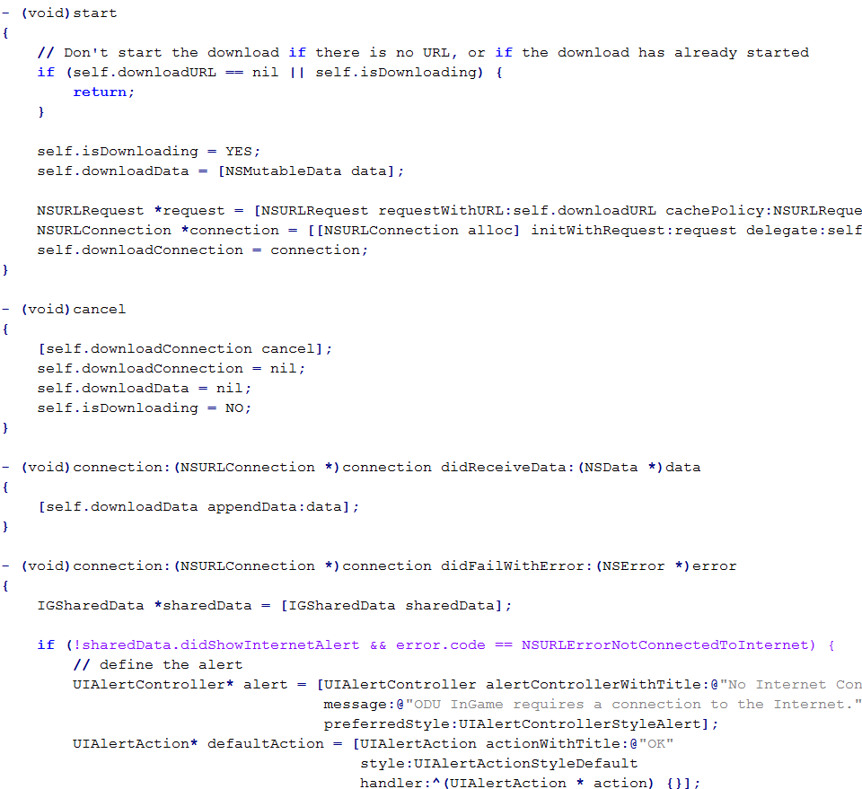
Compare C# to Objective C

Slide 11
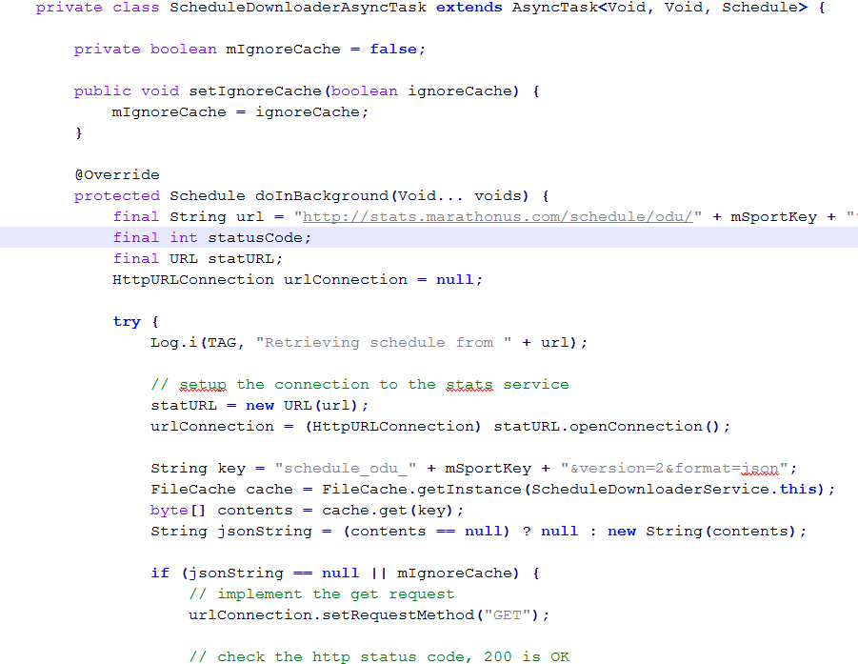
Compare C# to Java

Slide 12
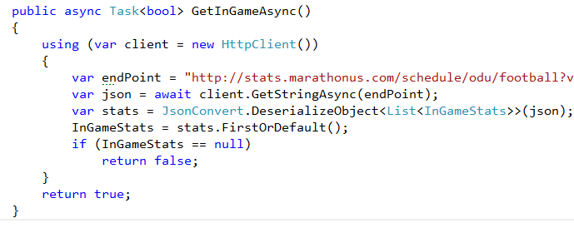
Compare C# to Java and Objective-C

Slide 13
Architecting Mobile Apps – Xamarin’s Approach
Traditional
Pixel Perfect Design
Access to 100% of Native SDK (even new stuff)
Can use Native 3rd Party Controls
Must Write UI For Each Platform
Forms
Prototyping / Line of Business
Write UI Once
Generates Native UI
Not All UI Controls Available
Notes:
will be slight differences of app between platforms that are not easily changed
you don't have complete control over app look on platforms
Custom renders can overcome some of the issues
This traditional approach to Xamarin development has some great benefits:
You use the native way of creating UI-> Storyboards in iOS, XML in Android
You have complete control over the UI, animations and special effects
Can access 100% of the platform features – even for new OS releases
Can use native 3rd party controls written in Java (Android) or Objective-C (iOS)
However, it has some drawbacks:
The UI definition is unique to the platform; must be written multiple times
Requires platform-specific code to connect UI to shared code layer
Xamarin.Forms is a set of libraries that provides a shared UI surface for iOS, Android and Windows:
Allows you to define the UI using a common set of controls
Great for data-entry (Forms) apps and for prototyping
Provides a higher level of code sharing than the traditional approach
Generates fully native UI so it looks and feels natural to each platform
Can leverage platform-specific APIs when necessary
Can customize the UI for each platform (although limited in places)
However, it also has drawbacks:
Not all controls are available; only controls which exist in all three platforms and are defined by Xamarin.Forms are supported
It's more difficult to leverage custom UI features
Since layout is managed directly by Xamarin.Forms, pixel-perfect designs are hard to replicate

Slide 14
Microsoft and Xamarin

Slide 15
Microsoft Acquires Xamarin
Acquisition Announced February 2016
Xamarin is Completely Free*
Visual Studio / Xamarin Studio Community Editions (Free)
Open Source (open.xamarin.com)
* Mac required to do iOS development
Notes:
Xamarin was $1000 per developer per platform per year
You are free to look at and contribute code
This is not your father’s Microsoft
Mac – Mac in Cloud, eBay

Slide 16
Xamarin Development Platforms
OS | IDE | Supported Platforms | Limitations
Windows | Visual Studio | Android iOS (via Mac Agent) UWP Windows Phone | Mac computer on same network iOS Emulator is on Mac
OS X | Visual Studio (Parallels) | Android iOS UWP Windows Phone | Emulators will be slow
 | Xamarin Studio | Android iOS | No Windows platforms
Notes:
Emulator within emulator on iOS

Slide 17
Xamarin iOS Development
Windows Computer
Windows 7 or higher
Visual Studio 2013/2015
Xamarin for Visual Studio
Mac Remote Agent
Mac Computer *
OS X El Capitan or higher
Xamarin Studio 5.10 or higher
Xamarin.iOS SDK
Xcode 7.0 or higher
*Mac computer must be on same network as Windows computer
Notes:
Mac agent connects the Windows compute to the Mac
iOS applications cannot be created without Apple’s compiler and they cannot be deployed without Apple’s certificates and code-signing tools
You’ll need apple developer id, sign into itunes connect, etc to code sign and deploy to the app store
** make sure your Xamarin versions stay in sync

Slide 18
Traditional Xamarin

Slide 19
Traditional Xamarin
C# code sharing (business logic, data access, web services)
Native UI development for each targeted platform
Must have Mac to design iOS UI (Mac Agent)
Get about 75% code reuse
Notes:
application logic is shared between platforms but UI designer is native

Slide 20
Xamarin Forms

Slide 21
Xamarin.Forms
Target iOS, Android, UWP with a single XAML
Platform specific projects for fine tuning
Get about 90% code reuse (varies per platform)
Over 40 pages, layouts, and controls
2-way databinding for data entry
Version 2.x so pretty mature
Uses MVVM presentation pattern
Notes:
application logic is shared between platforms but UI designer is native
XAML is not WPF or Silverlight XAML

Slide 22
Xamarin.Forms
Page is abstract class; defines single screen
Layouts are UI containers; provide structure (Stack, Grid)
View is base class for all visual controls (Label, Button)
Views utilize properties to adjust visual behavior
Platform render takes XAML and renders it natively on each platform at runtime
Cannot specify position of elements with coordinates (use layout containers like StackLayout)
Device.OnPlatform allows for platform specific code
-
Notes:
Terminology is a little different than what you’d expect
Can create UI in code or XAML but complex layouts should be done in XAML
Not pixel perfect

Slide 23
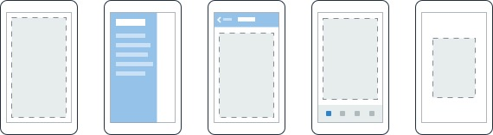
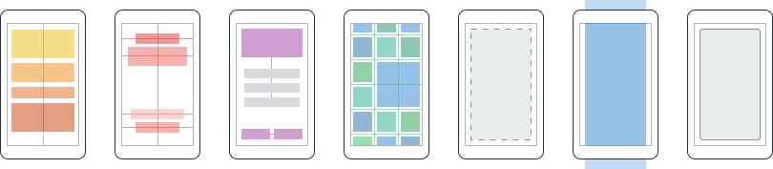
Layouts
Xamarin.Forms
Pages
Content
MasterDetail
Navigation
Tabbed
Carousel
Stack
Absolute
Relative
Grid
ContentView
ScrollView
Frame
Notes:
First you have a set of pages for each screen of your application
There are things like Content, and MasterDetail which gives you a nice flyout
With a tabbed view you get the correct look on each platform - iOS on bottom, Android on top, and on WP you have a Pivot control
Inside of a page are layouts
A lot of options from something simple like a stack panel to complex and powerful grids

Slide 24
Setup/Solution Types

Slide 25
Model View ViewModel (MVVM)
A design pattern
Model provides underlying layer
ViewModel connects the Model to the View
View is the UI
View <-> ViewModel <-> Model
Designed to take advantage of XAML and XAML data bindings

Slide 26
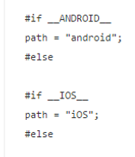
Shared Projects
Each code file will be compiled for each destination (Android, iOS, Windows)
Create classes as per usual but if you want to do something platform specific you implement a compiler directive around the code
Maintenance problems with larger projects
Notes:
Shared Projects vs Portable Class Library

Slide 27
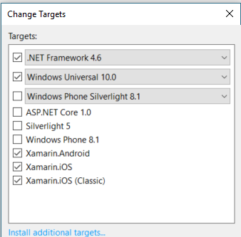
Portable Class Library
1 assembly, multiple platforms
Compiled against a general .NET subset which is compatible to all platforms you want (no platform specific code)
Don’t need to insert compiler directives to switch code
Go to the Properties and set the Targets for the project
Notes:
iOS (Classic) – 32 bits, supports older versions of Mac OS or hardware
iOS – modern, supports 32 and 64 bits

Slide 28
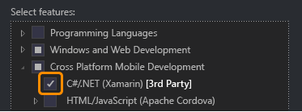
Installation
Included with ALL versions of Visual Studio 2015 (Community, Professional, or Enterprise)
If you plan on targeting Windows devices, also check Windows and Web Development > Universal Windows App Development Tools

Slide 29

Update Xamarin
Xamarin updates are not integrated into Visual Studio updates (yet)
Tools > Options > Xamarin or Tools > Options > Xamarin > Other

Slide 30
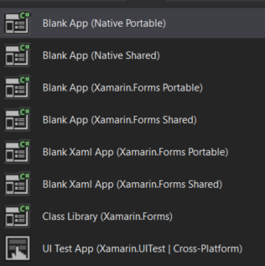
New Cross Platform Solution
Native – Shared Code / Native UI
Forms – Shared Code / Shared UI
XAML – Shared Code / Shared UI
Class Library
UI Test
Notes:
Once you’ve installed and updated Xamarin
Native – shared code/ native UI
Forms – shared code / shared UI (sample form designed with code)
XAML – shared code / shared UI (sample form designed with XAML)
Class Library
UI Test

Slide 31
Native Solution Designers
Use the native designer to design the UI for each platform
The native designers require you to learn the ins and outs of each platform
Must be connected to a Mac with the Mac Agent, Xamarin, and Xcode to design the iOS UI

Slide 32
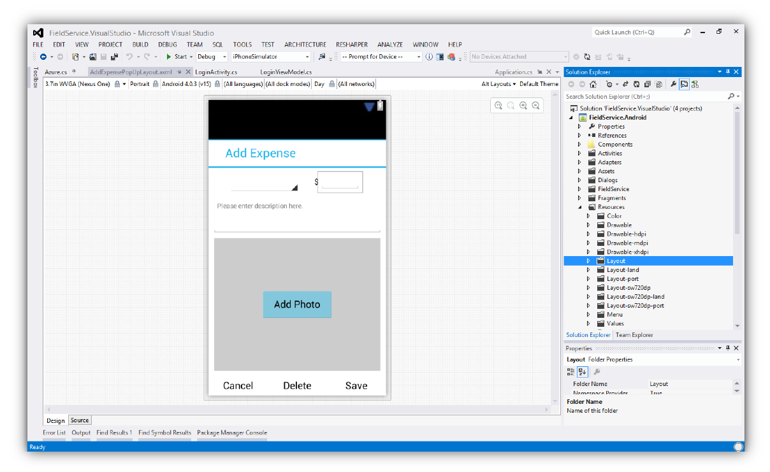
Native Solution – Android Designer

Slide 33
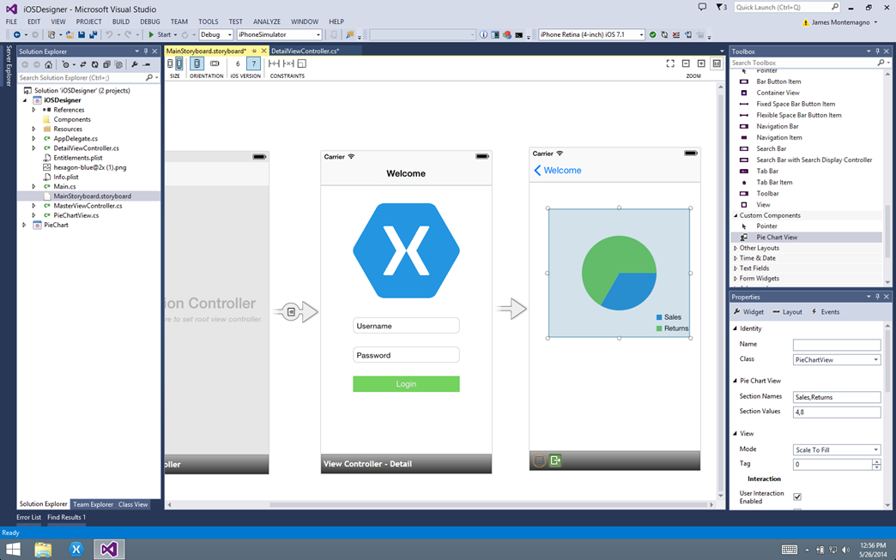
Native Solution – iOS Designer
Notes:
Show native designers

Slide 34
Forms Solution Design
Use code class or XAML to define UI
Code class is derived from ContentPage
XAML gives a better visual structure than code (designer vs developer)
XAML is generally easier to maintain than code
You can choose to precompile XAML
No design tools for XAML, must hand write
2 way data binding is powerful
XAML in Xamarin is not SilverLight or WPF XAML
Notes:
It is up to you to use code or XAML, you can define your UI completely in code but it is more efficient to use XAML
XAML is based on the designer doing the UI then the developer coding the code behind
You can precompile XAML with an assembly attribute or at the class level – gives you compile time checking, reduces size of your app, faster

Slide 35
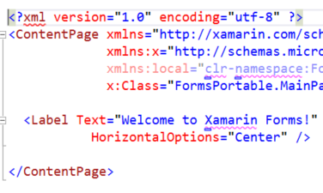
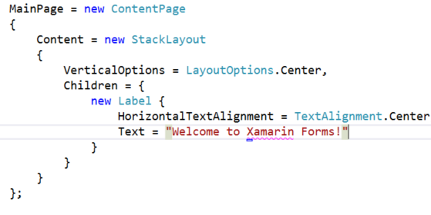
Forms Solution Design – Code vs XAML
Notes:
Note the FontSize Large attribute is much easier to define in XAML

Slide 36
Emulators/Debugging

Slide 37
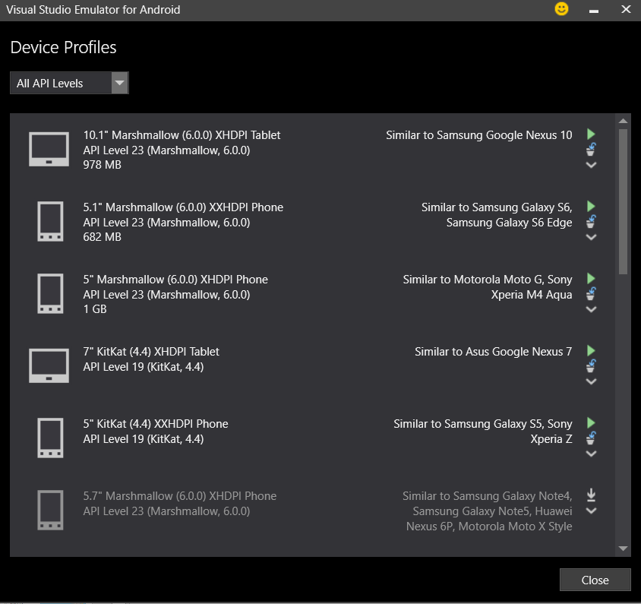
Visual Studio Emulator for Android
Marshmallow emulators were developed by MS and are faster (use Hyper-V)
Best to use only one virtualization technology on a machine
Will not work with Windows Emulation
Look at memory requirements
Notes:
You will have problems if you are using virtual box or vm player and try to use Hyper-V
Show browser
Show GPS setting

Slide 38
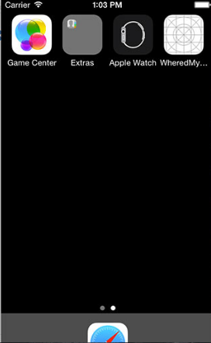
iPhone Simulators
Separate install on Mac
Run/debug code in Visual Studio on Windows
Simulator runs on the Mac
Notes:
Show on Mac

Slide 39
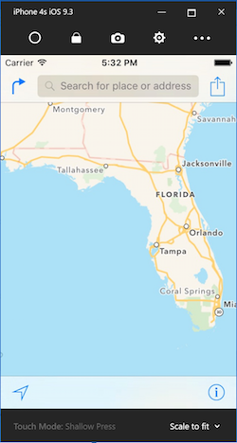
iOS Simulator for Windows
Test and debug from Visual Studio on Windows
Requires Mac Agent
Preview Edition Updated Sept 2016
https://developer.xamarin.com/guides/cross-platform/windows/ios-simulator/

Slide 40
Resources
Creating Mobile Apps with Xamarin Forms by Charles Petzold
Xamarin Developer Website https://developer.xamarin.com
Xamarin University https://www.xamarin.com/university
The Xamarin Show on Channel 9
Open Source Components for Xamarin on GitHub
Follow @JamesMontemagno
Notes:
Free eBook - https://developer.xamarin.com/guides/xamarin-forms/creating-mobile-apps-xamarin-forms/
Xamarin University Training
Free on-demand access
Build native iOS and Android apps in C# with expert getting-started videos (subset of classes offered)
Xamarin.Forms Labs
https://github.com/XLabs/Xamarin-Forms-Labs
Open Source Components
https://github.com/xamarin/XamarinComponents
The Xamarin Show on Channel 9
https://channel9.msdn.com/Shows/XamarinShow/Sharing-Code-Across-iOS-Android-and-Windows

Slide 41
Getting Started With Xamarin and Visual Studio 2015
THANK YOU!!!
John Hadzima
Senior IT Consultant
Marathon Consulting

Slide 42
Additional Resources

Slide 43
Custom Renderers
Each element in Xamarin Forms is supported by a special class called a renderer
The renderer creates the native control on each platform based on the Xamarin Forms page, layout, or control
You can write your own renderers if the out of the box controls do not meet your needs
Renderers affect appearance and behavior of controls
Much easier to implement in a PCL than a shared project

Slide 44
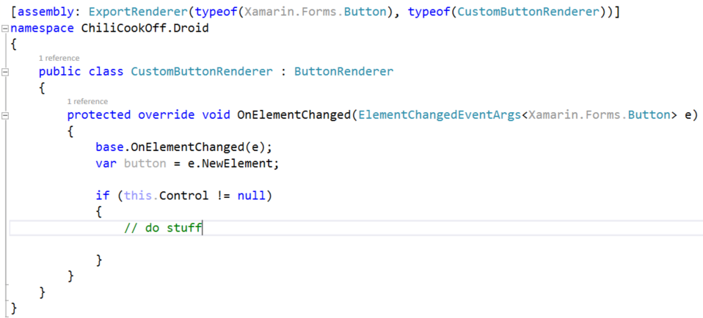
Custom Renderers
Notes:
Override the base Xamarin Forms button renderer
Must include the assembly attribute - connects the custom renderer to Xamarin Forms Buttons

Slide 45
Azure Mobile Services
Easy Tables
Authentication (Facebook, Google, AD)
Push Notifications
Offline sync

